Slide 1
Project MIS
6900
Sprint - I

Slide 2


1. Intro
Team
Project
Goal
- What
- When
- How Much
Team Responsibilities
Product Backlog
- User Stories
- Priority
- Size Estimate
Acceptance Criteria

Slide 3
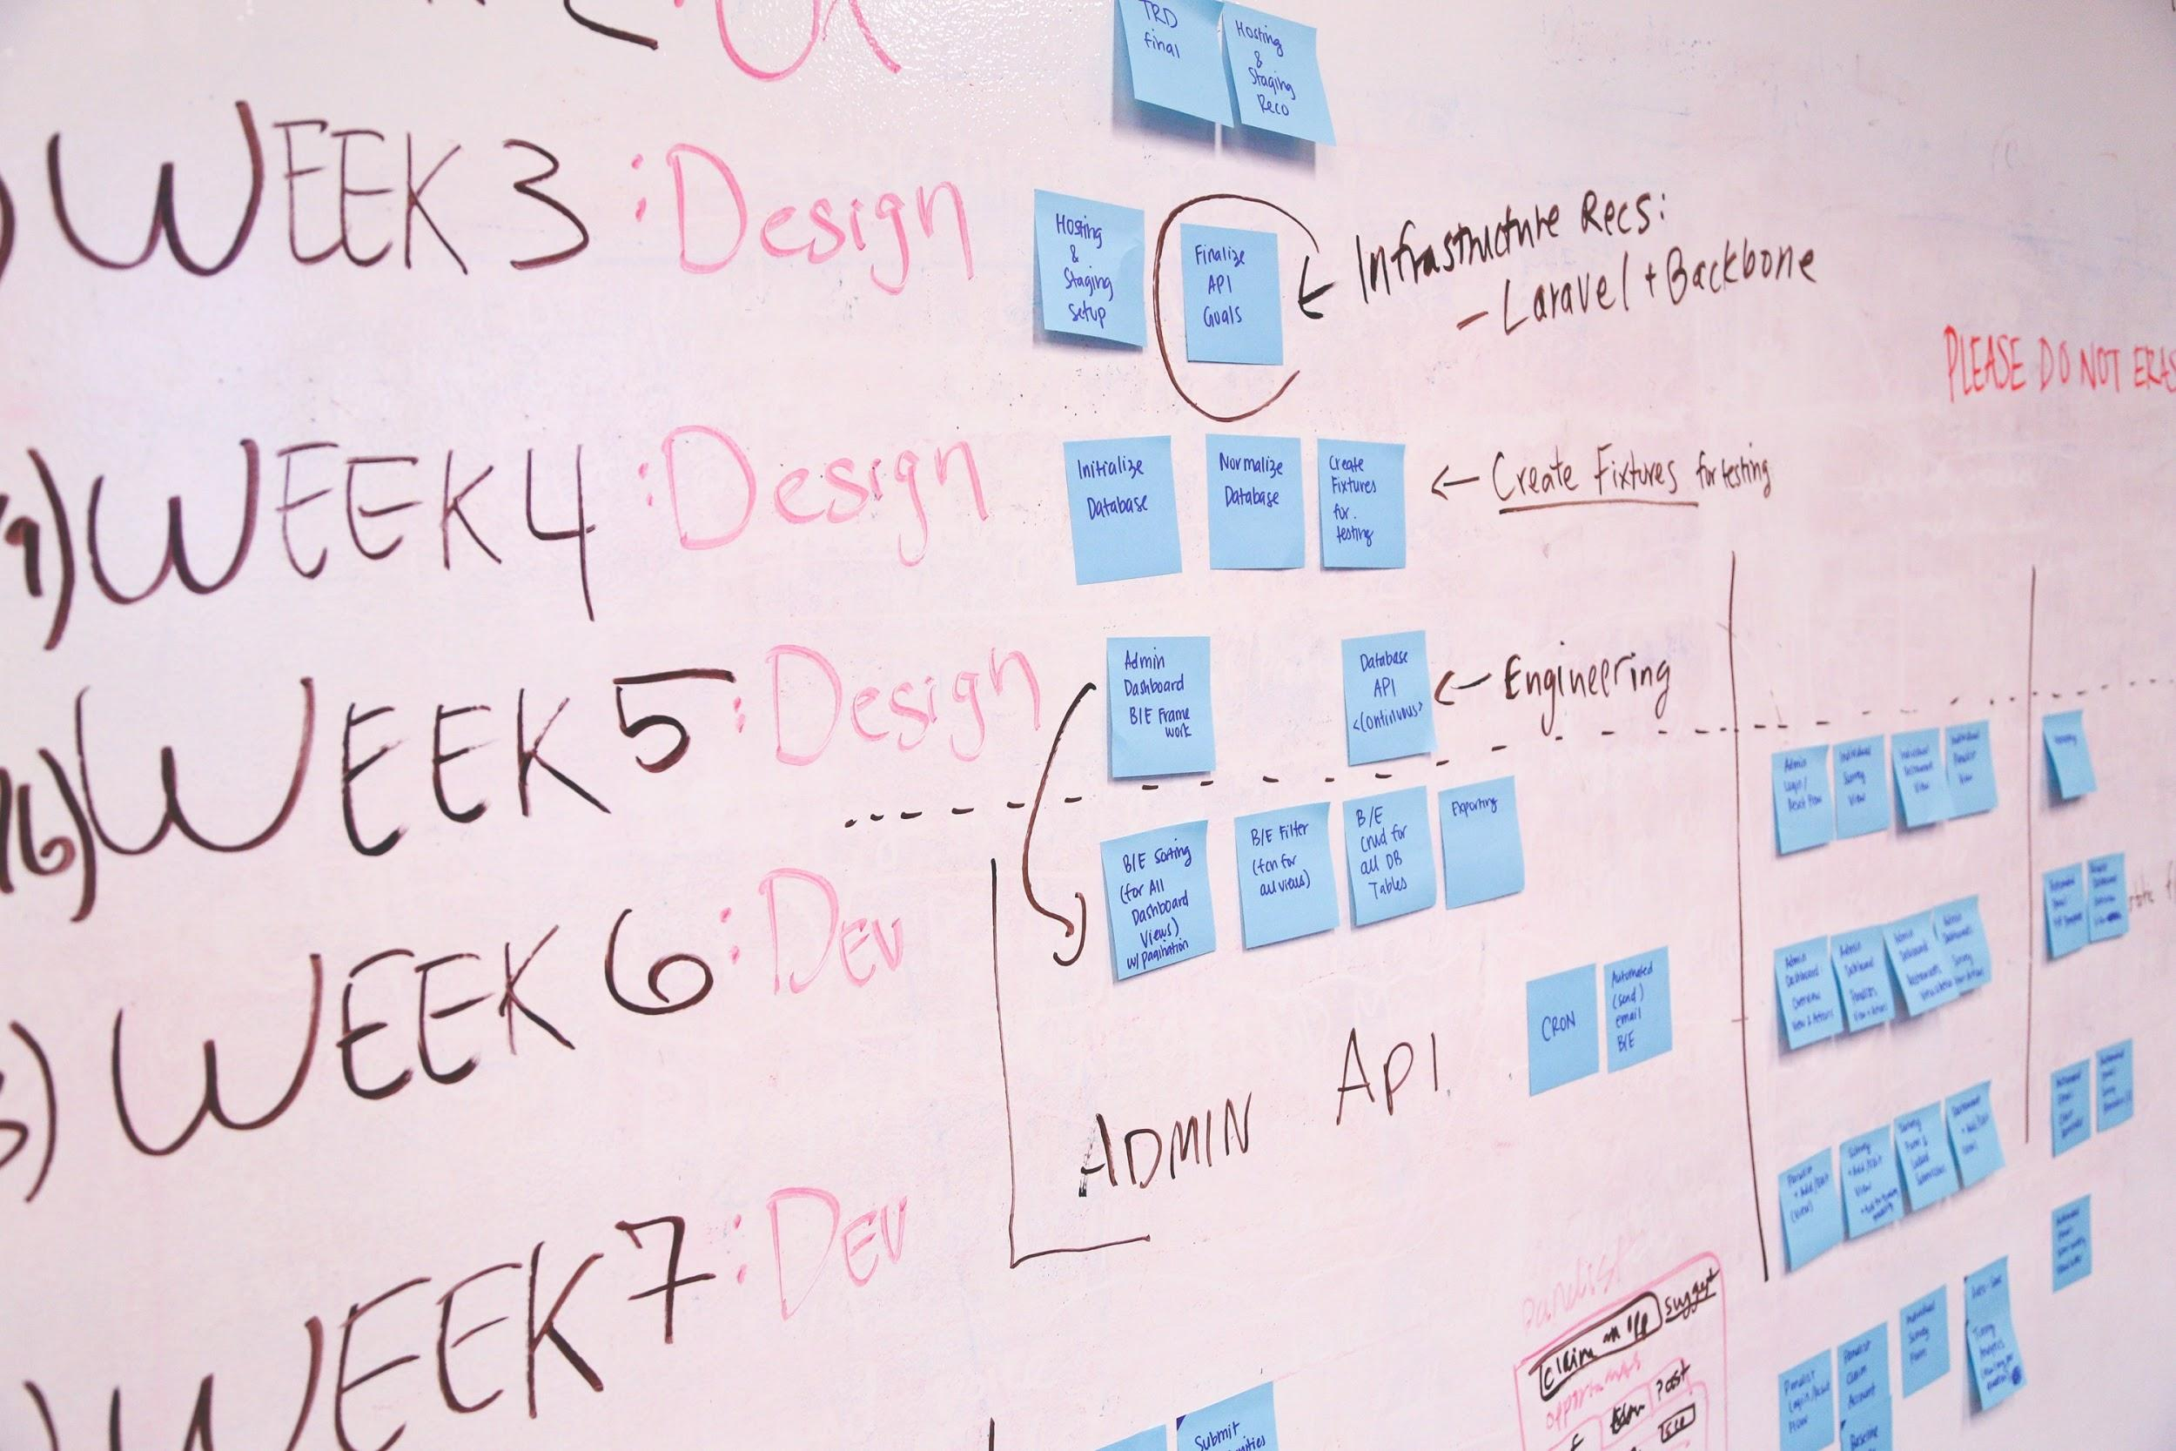
Team
Team members:
Chetan Birthare
Yixin Zhao
Kumar Akshat

Slide 4
Spring goal
Finish the Landing page, registration and login page
2. Implement part of the algo for the main page as well as the user login logout logic.
3. Cleaning the stock data for backend and get it ready to use for front-end.

Slide 5
Stock Market: Data API
Alpha-vantage
Data Extracted as Dictionary
Data Cleaning
Specific Data selected, rest are removed. Result is stored as .csv file
Fast Update
Re-run of program for any ticker will just get the data not already available, saving time. Fast, efficient and quick results.

Slide 6
2. Sprint 1
Things to be done in Sprint 1:
What: The frontend design, plus the api request setup.
When: Sprint 1 part
How Much: Front end design plus routing setup

Slide 7
Members Responsibility:
Kumar Akshat
Backend
Chetan Birthare
Backend
Yixin Zhao
Frontend

Slide 8
Product Backlog:
Setup the landing page- high, Size - 2
Setup the login & register page -high, Size - 4
Cleaning the data for backend -high, Size - 4
Scriping the stock data from 1999 to now including all company in US - High, Size -4
Make back-end can auto update every 24h -medium, Size - 3
Setup the logic for user login and logout - Medium, Size - 3
Setup the sidebar for multiple page: Priority - Medium, Size - 3
Setup the top bar for multiple page: Priority - Medium, Size - 3
Setup the logic for search bar autocomplete- Low, Size - 4
Log out the data into a json file - Low, Size -3

Slide 9
Accepted Criteria:
Clean layout in landing page
Given a user when user fill out the login or register form, then user information should be handled by backend and stored in database.
Make all the stock data should sorted by time and company name
When user is typing in search bar the autocompletion algo should run
Proper Data json output
Accurate data storage
Back-end auto update

Slide 10

Project progress - Landing

Slide 11

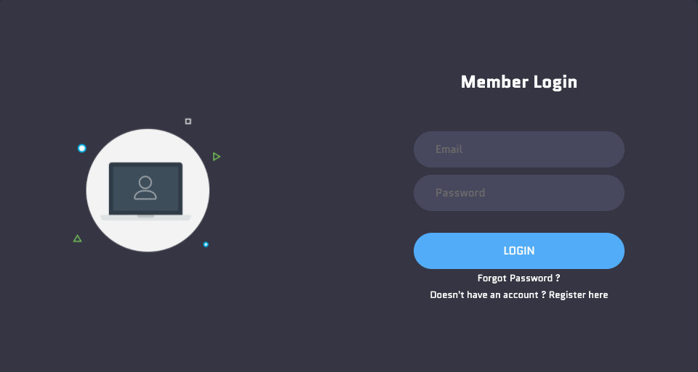
Login & register

Slide 12
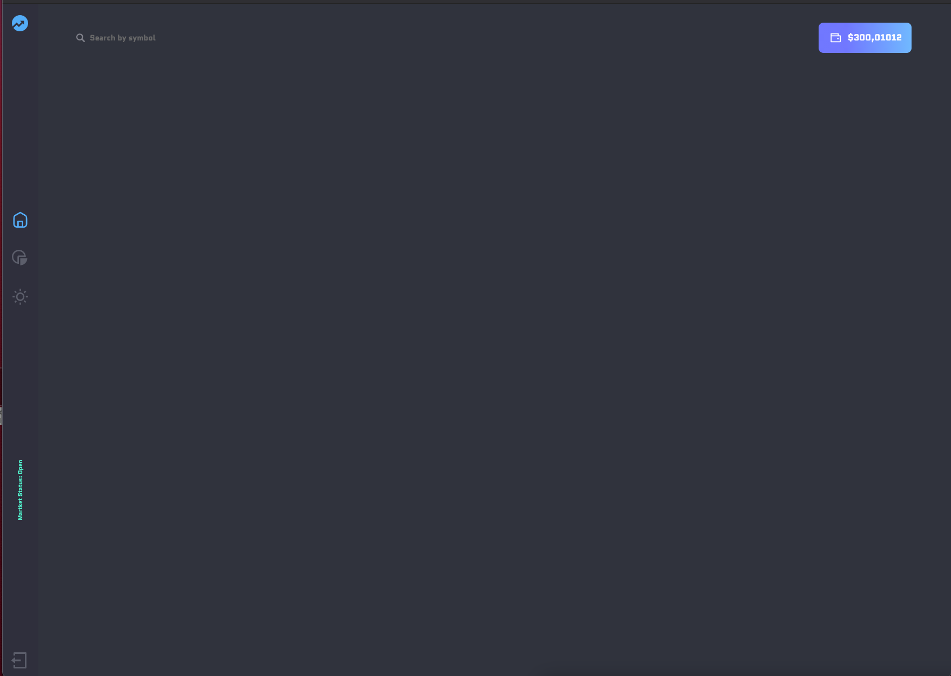
Topbar & side bar

Slide 13
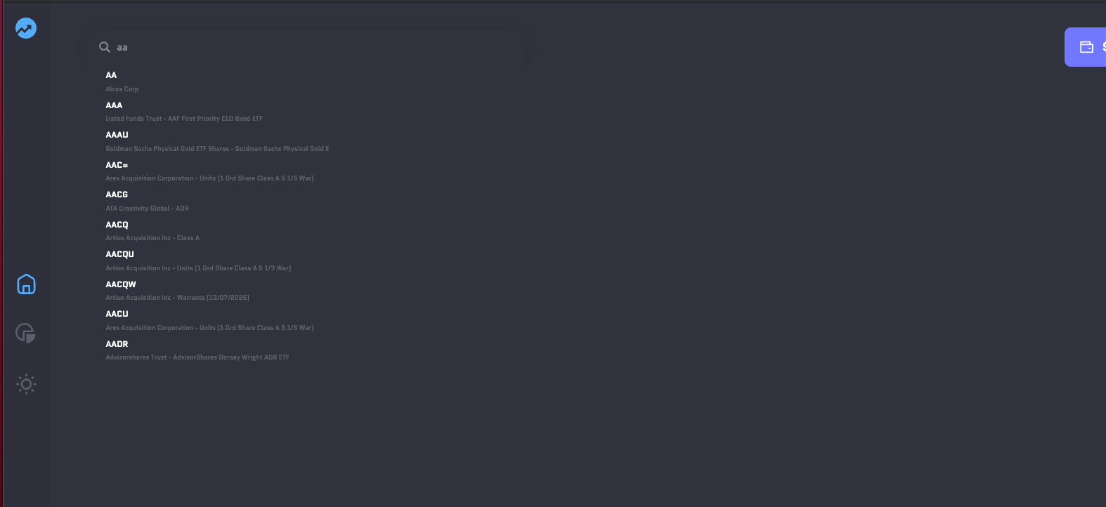
Autocompletion Logic

Slide 14
Good luck!
To all of us!
MIS 6900

